Slide 1

QuickBazaar An Online Marketplace
Group Members:
Name: Rafidul Islam ID:1912152642
Name: Md Rafin Al Zhehad ID:1911626642
Name: Md. Riyad-Ur-Rahman ID:1911125642
01

Slide 2
1
What is the problem?
Offline shopping is time consuming. Nowadays, traffic in Bangladesh is unbearable. So, it wastes our valuable time.
Sometimes it's impossible to move around in marketplaces and malls because of the crowds.
Shopping malls cause environment pollution as well.
The biggest problem with offline shopping is the lack of options because there are only so many products that can be sold in real stores.
Limited market areas and people cannot do shopping 24/7.
This is why we are planning to build this online marketplace which lets you to get rid of all these problems.
2
Why is it Interesting?
This project is interesting because people can purchase their necessary products really quick whenever and from anywhere they want. They don’t need to go different places for buying the products. This online marketplace gives us the flexibility and, makes our life a lot easier!

Slide 3
How did we come come up with the idea?
The usefulness of Online marketplace in pandemic inspired us to come up with this idea.
The traffic in our country nowadays discourages us to go far from our home to buy anything.

Slide 4
Related Works
1. S. E. Ullah, T. Alauddin and H. U. Zaman, "Developing an E-commerce website," 2016 International Conference on Microelectronics, Computing and Communications (MicroCom), 2016, pp. 1-4, doi: 10.1109/MicroCom.2016.7522526.
2. Alsaadi, Elham. (2020). Building and Developing E-commerce Website. International Journal of Science and Research (IJSR). 3. 1419-1425.
3. Michael Luca, “Designing Online Marketplaces: Trust and Reputation Mechanisms”, 2017

Slide 5
Related Works
Daraz: Daraz is the leading e-commerce marketplace across South Asia. It is very popular in Bangladesh. They ensure 100% authenticity, best price, fastest delivery, customer service and protection, easy and free return policy and many more services which is very similar to our project.
Alibaba: Alibaba is an international marketplace for wholesale purchases where customers may get the best deals on big quantities of goods. Alibaba enables customers to develop custom items, bargain directly with producers, and save a lot of money.
Flipkart: The most well-known eCommerce site in India, Flipkart, is encouraging numerous Indian companies to enter the cutthroat online retail market. The platform provided by this multi-vendor website allows vendors to showcase their goods to website users.
Chaldal: Bangladesh's largest online grocery market is Chaldal. The business, which began as a tiny online grocery retailer, has since grown into a massive food corporation with a number of verticals that support the grocery at its core.

Slide 6
Related Works
5. Amazon: The enormous online store Amazon.com sells a wide range of products, including books, music, movies, housewares, electronics, toys, and many others, either directly to its millions of consumers or by acting as a middleman between them and other sellers.
6. Rokomari: Rokomari also functions as an online marketplace. It works with publishers who market their books on this site. A minor number of books written in other languages can be found here, however the majority of the books in this market are written in Bengali and English. It mostly focuses on selling books whereas our website will have variety of products.
These are some related works to our project. But in our project, we want to keep variety of products. Specially, we will focus on art and crafts products for the customers who loves arts because art related products are not that much available online.

Slide 7
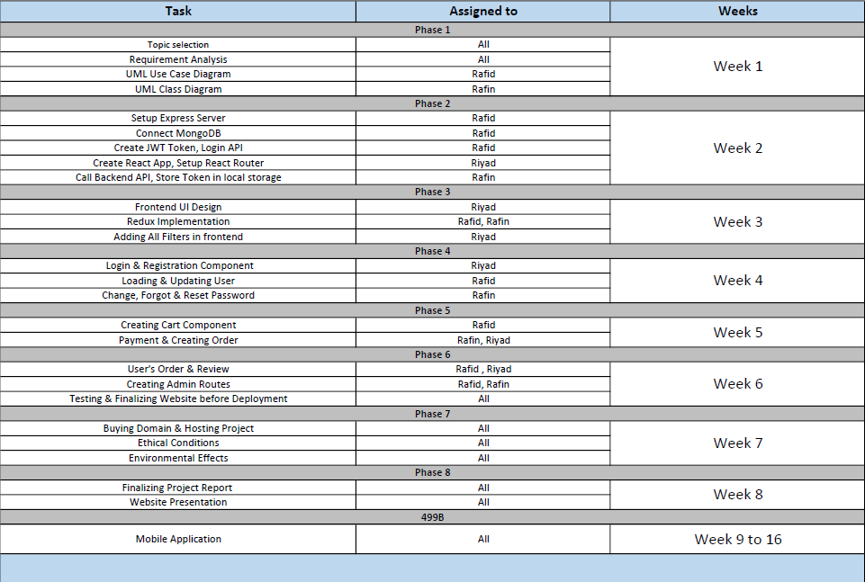
Working Plan

Slide 8
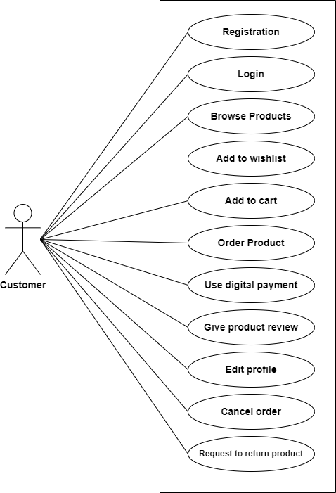
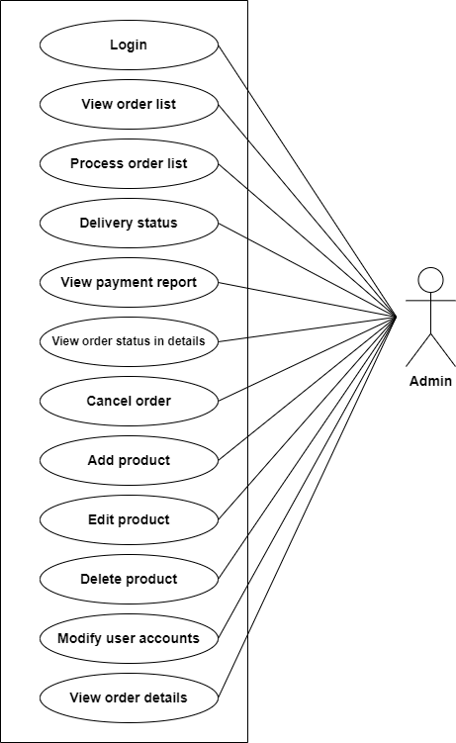
Working Plan (Continues)
UML Use Case Diagram

Slide 9
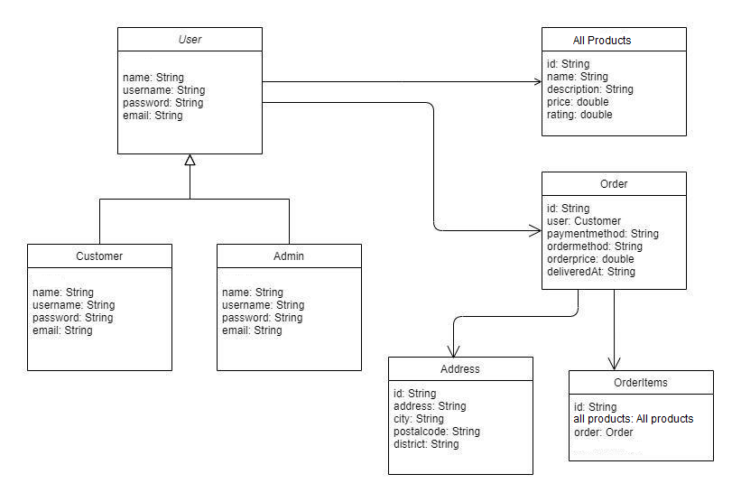
Working Plan (continues)
UML Class Diagram

Slide 10
Project Budget
Service | Yearly Cost
Domain | $15
Hosting | $15
Total Cost | $30

Slide 11
Thank you!

